Slide 1

WORLD CUP MATCHES

Slide 2




Agenda
Problem Statement
Business Value
Methodology
Findings and Recommendations
Problem Statement
Business Value
Methodology
Findings and Recommendations
Future Work

Slide 3
Problem Statement
Agenda
Business Value
Methodology
Recommendations and Future work
Problem Statement
01
Objective:
Clearly outline the goals and objectives you want to achieve through data analysis. For example, you might aim to identify patterns, trends, or insights related to World Cup matches. This could include goals scored, match outcomes, or team performance.
Problem:
Based on your analysis, formulate insights and recommendations that can inform decision-making.
Remember that the specific steps and analysis will depend on the nature of the World Cup matches data and your business goals.
.
Proposed Solution:
In this project, we used the data collected from the world cup matches. This was done through analysis and visualization and correlating data collected from the .matches the away games home games and calculating the average revenue during the world cup matches. The study also shows trends and curves in the data
02
Benefits:
Develop a data driven decision support system to
Optimize resources utilization
03

Slide 4
Business Value
Agenda
Problem Statement
Methodology
Recommendations and Future work
Home Game
Prediction of matches
Number of people who attended
Attendance over the years
new feature goals
I used a new feature goals with this I was able to analyze and visualize total goals in a world cup matches
Resource Optimization
Used visualization to determine home team goals and away team goals
Prediction of matches

Slide 5

Methodology
Agenda
Problem Statement
Business Value
Recommendations and Future work
Data Collection and Analysis:
Data was collected retrospectively on attendance over a given year of 1930
During the data collection and analysis period, the attendance shows that there were 30000 but as the KDE line plot moves toward
the right showing the numbers were slightly increasing and having an attendance of 175000 at the end .
Data Cleaning
Data cleaning was done on columns with missing values as well as non-numeric values.

Slide 6
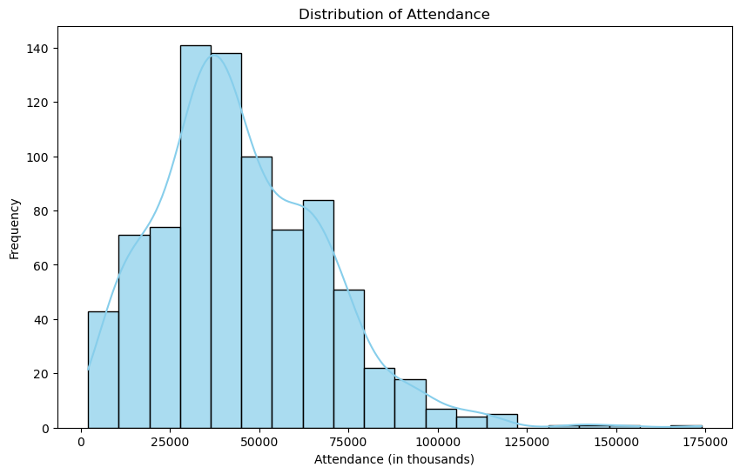
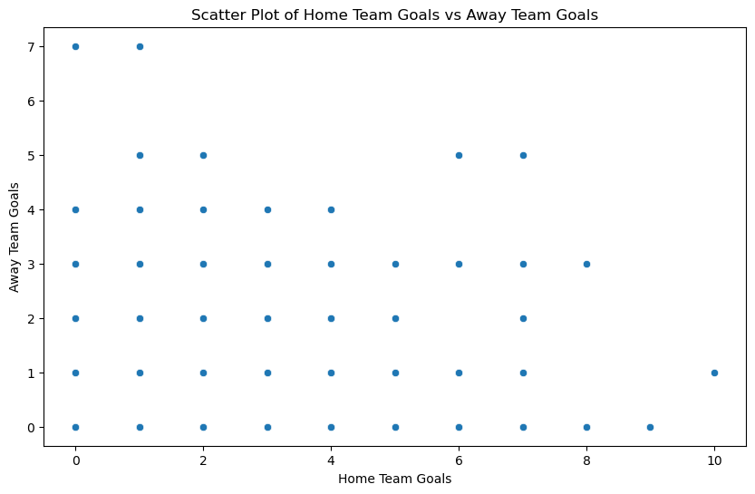
Findings
Agenda
Problem Statement
Business Value
Methodology

Slide 7
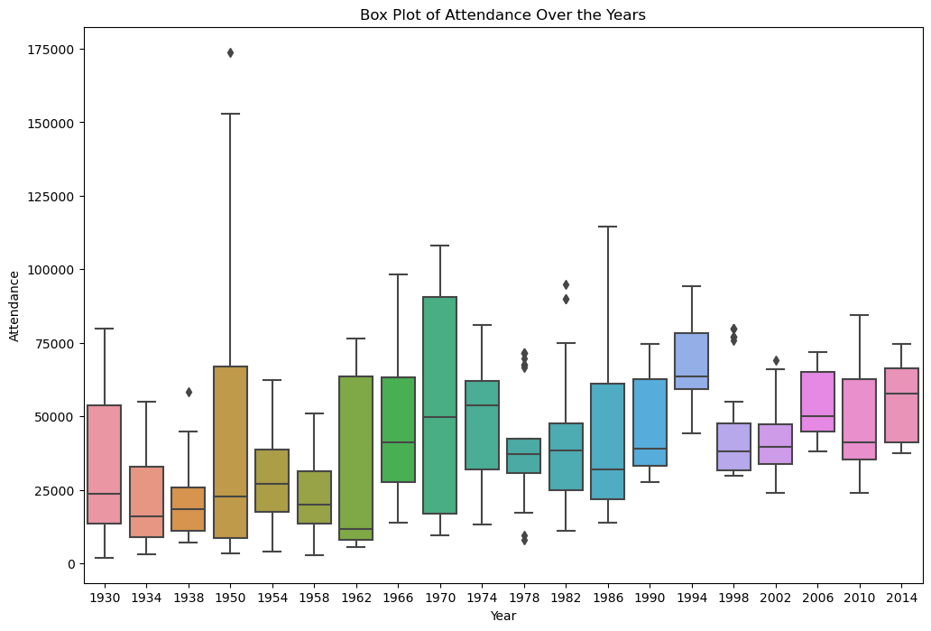
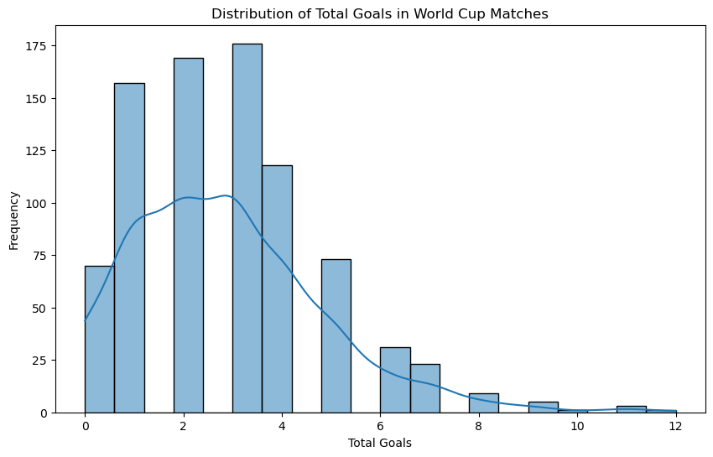
Findings
Agenda
Problem Statement
Business Value
Methodology

Slide 8
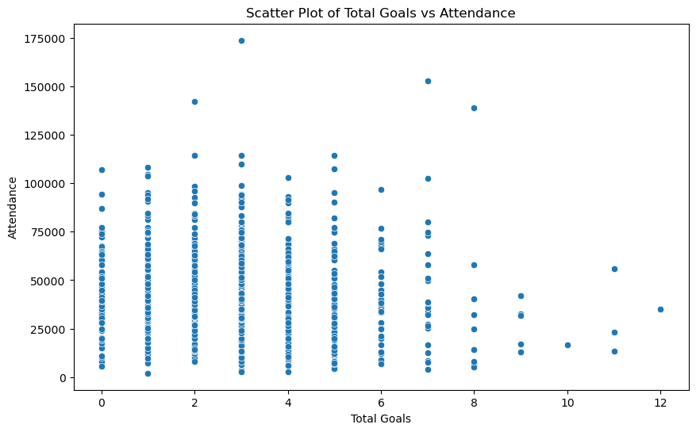
Findings
Agenda
Problem Statement
Business Value
Methodology

Slide 9
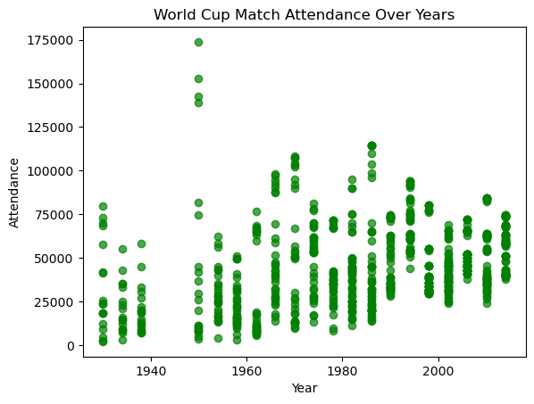
Findings
Agenda
Problem Statement
Business Value
Methodology

Slide 10
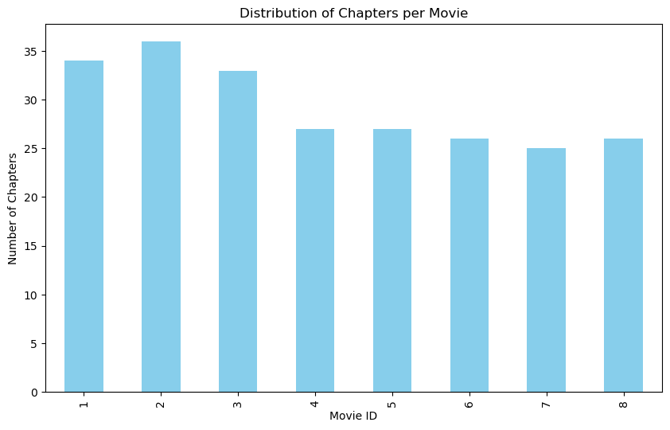
Findings
Agenda
Problem Statement
Business Value
Methodology

Slide 11
Appendix
Agenda
Problem Statement
Business Value
Methodology
Graphs used:
Histo plot:
Histo plots were used for plotting the distribution of attendance
2. Scatter Plots:
Scatter plots are best used for revealing relationships or patterns between two numerical variables.. In this review they were used to show the correlation between home team goals and away team goals
3. Boxplot: visualize the spread of a numerical column by a categorical column this visualized the attendance over years
box plot this was used to visualize the spread of total goals per year .

Slide 12
THANK YOU

